Slide 1
Android Botnet Detection Using Machine Learning
Vidyavardhini’s College of Engineering & Technology
K.T. Marg, Vartak College Campus, Vasai Rd, Vasai-Virar, Maharashtra 401202
Department of Artificial Intelligence and Data Science
Yash Patil
Chetan Sapkal
Shubhamkar Patra
Date: 17/03/2023

Slide 2
Contents
Abstract
Introduction
Problem Definition
Proposed approach / System Design
Implementation / Methodology
Results & Discussion
Conclusion
References

Slide 3
Abstract
A botnet is widely spreading malware among mobile application.
Android botnets are networks of compromised devices used to spread malicious software and execute malicious activities.
It’s mainly aim to hack the entire system and abduct the details of the user.
Machine Learning is a powerful tool for detecting these threats and protecting users from harm.

Slide 4
What is Botnet ?
A Botnet is a network of compromised computers under the control of a remote hacker.
Controller of a botnet is able to direct the activities of these compromised computers.
Botnet Terminology
Bot Herder(Bot Master)
Bot
Bot Client
IRC Server
Command and Control Channel(C&C)

Slide 5
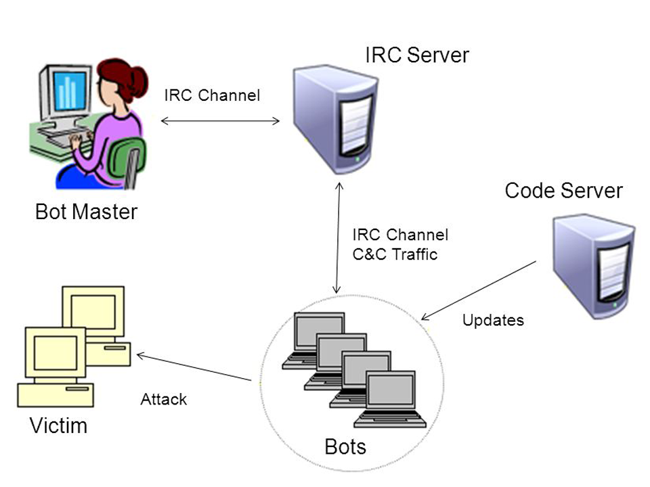
Botnet(Terminology)

Slide 6
Problem Definition
Bots are stealthy on the infected machines.
Bot infection is usually a multi-faceted and multi-phased process.
Bots are dynamically evolving.

Slide 7
Proposed approach / System Design
Using Machine Learning for Android botnet detection, It’s offers several benefits.
It’s has ability to detect new types of botnets in real-time and across different devices.
These algorithms can identify patterns in network traffic that indicate malicious activity.

Slide 8
Implementation / Methodology
The feature extraction methodology is used with the support vector machine to detect botnet-infected apps.
ISCX dataset is used to test the botnet applications.
The dataset contain botnet infected-apps and our proposed methodology is used to detect it.

Slide 9
Results & Discussion
Testing on the predefined datasets got the conclusion of successfully testing against the dataset on 342 static app features to distinguish between botnet apps and normal apps.

Slide 10
Conclusion
Machine Learning for Android botnet detection is a powerful tool for protecting users from harm. It offers the ability to detect new types of botnets, the ability to detect botnets in real-time, and the ability to detect botnets across different devices.
However, there are several challenges associated with using Machine Learning for Android botnet detection. These include the need for large amounts of labeled data, the need for accurate labeling, and the need for robust algorithms.

Slide 11
References
1. McAfee Mobile Threat Report Q1. 2020. Available online: https://www.mcafee.com/en-us/consumer-support/2020 mobile threat report.html (accessed on 5 December 2020).
2. Yerima, S.Y.; Khan, S. Longitudinal Performance Analysis of Machine Learning based Android Malware Detectors. In Proceedings of the 2019 International Conference on Cyber Security and Protection of Digital Services (Cyber Security), Oxford, UK,3–4 June 2019.
3. Grill, B.B.; Ruthven, M.; Zhao, X. “Detecting and Eliminating Chamois, a Fraud Botnet on Android” Android Developers Blog. March 2017. Available online: https://androiddevelopers.googleblog.com/2017/03/detecting-and-eliminating-chamois-fraud. html (accessed on 10 December 2020).
4. Chris Brook “Google Eliminates Android Adfraud Botnet Chamois” Threat Post. March 2017. Available online: https://threatpost.com/google-eliminates-android-adfraud-botnet-chamois/124311/ (accessed on 10 December 2020).

Slide 12
5. W. T. Strayer, D. Lapsley, R. Walsh, and C. Livadas, “Botnet detection based on network behavior,” Advances in Information Security, vol. 36, pp. 1–24, 2019.
6. L. Atzori, A. Iera, and G. Morabito, “The internet of things: a survey,” Computer Networks, vol. 54, no. 15, pp. 2787–2805, 2020.
7. M. Feily, A. Shahrestani, and S. Ramadass, “A survey of botnet and botnet detection,” in Proceedings of the 3rd International Conference on Emerging Security Information, Systems and Technologies (SECURWARE ’09), pp. 268–273, June 2021.

Slide 13
Thank You

